Slide 1
Google Namebench and the Raspberry Pi DNS
Michael Gicking

Slide 2
Background
Domain Name Services are what associate a URL (https://www.google.com) with the IP address of the corresponding server (74.125.224.72)
You can see this by typing http://74.125.224.72/ into the address bar instead of https://www.google.com
However, doing this will mean you will be logged out of your google account. Fun fact
Without knowing the IP address of a web site, we would never be able to view that site.

Slide 3
Google Namebench
“Are you a power-user with 5 minutes to spare? Do you want a faster internet experience? Try out namebench. It hunts down the fastest DNS servers available for your computer to use.”
Namebench runs a fair and thorough benchmark using your web browser history, tcpdump output, or standardized datasets in order to provide an individualized recommendation
Available with a graphical user interface as well as a command-line interface

Slide 4
How it works
Written using Python, Tkinter, PyObjC, dnspython, jinja2, and graphy.
Based on the option you select for Data Source (I use chrome to give me the best DNS for the sites I visit most), the program will query several thousand different DNS servers around the globe, asking for a couple hundred different websites and will use response time and accuracy to determine DNS rankings and allow you to choose which one you want.

Slide 5
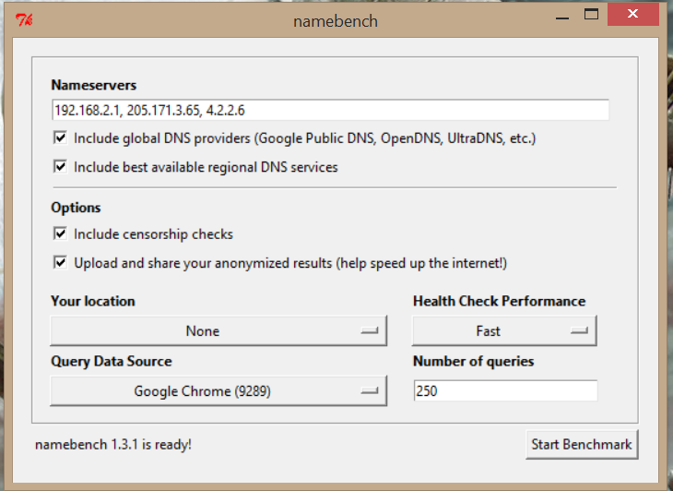
Data Source Options:
-Google Chrome
-Top 2000 websites
-Cache Latency Test
-50/50 hit/miss
-100% hit
-100% miss

Slide 6
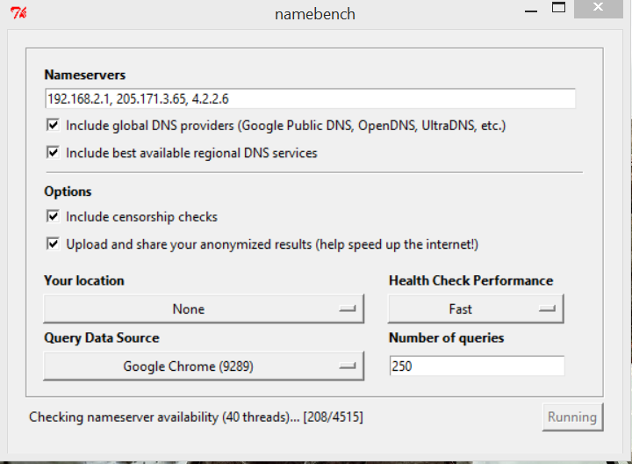
**This step takes forever, so feel free to laze about watching Netflix or making dinner

Slide 7
WHAT IT DOES!!!
Checks nameserver availability
Runs health checks on those nameservers
Runs cache sharing checks
Final health checks
Runs censorship checks on the finalists
Queries the finalists to test speed and accuracy
Takes you to summary page

Slide 8
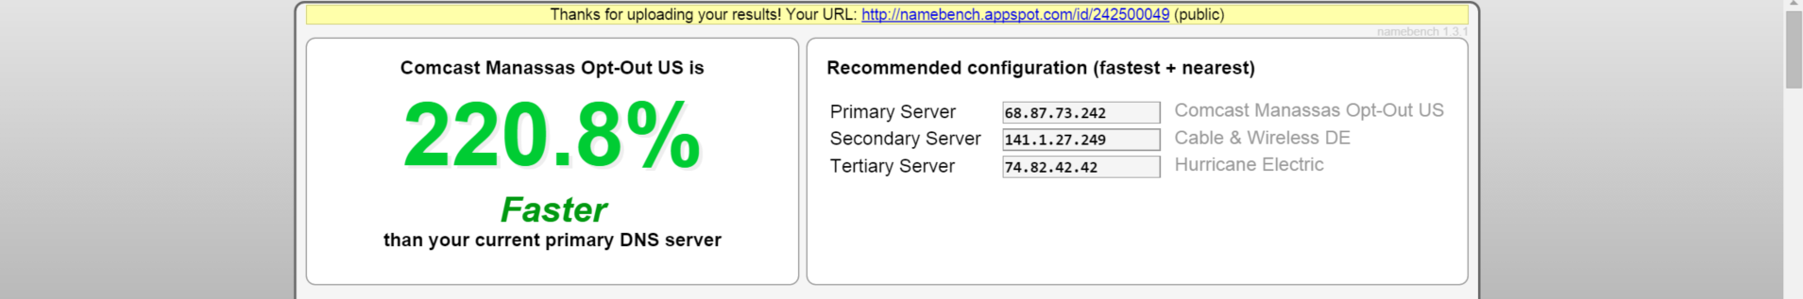
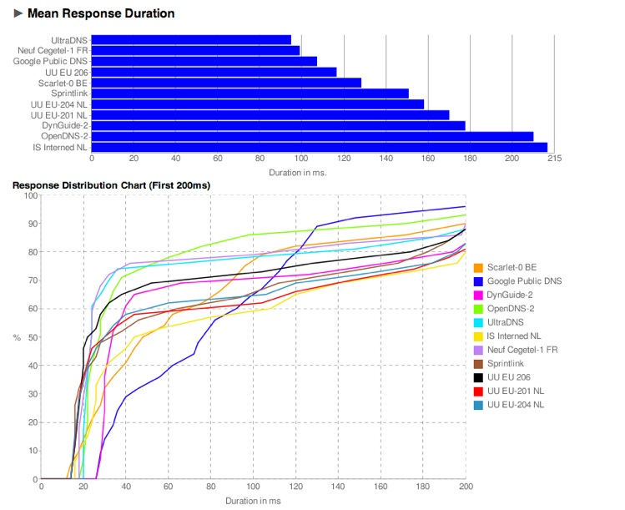
PRESTO!!!
Now you can sort through all the data and determine which DNS Server is best for you!
Setting DNS Server in Windows OS:
Go to Network and Sharing Center
Click on Change Adapter Settings
Right click on the adapter you use and choose Properties
Scroll down to Internet Protocol version 4, choose Properties
Set the DNS Server IP addresses

Slide 9
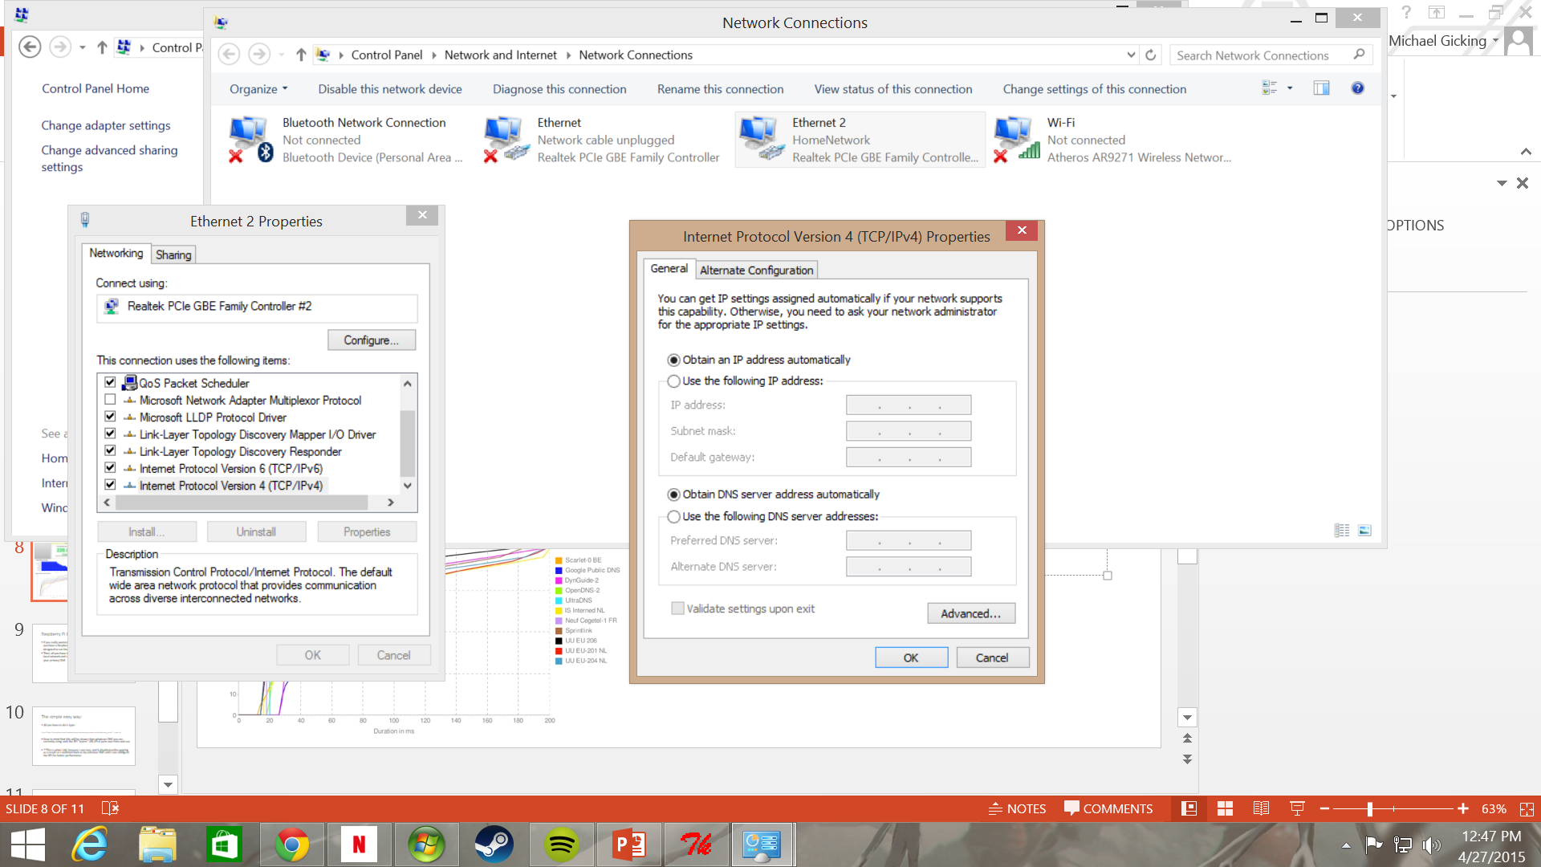

Slide 10
Raspberry Pi DNS
If you really wanted to go all out in terms of performance, you could purchase a Raspberry Pi online (they’re cheap as dirt mini computers designed to run linux based Operating Systems)
Then, all you have to do is set it up to run as a DNS cache on your local network and configure your client systems to use the RPi as your primary DNS

Slide 11
The simple easy way:
All you have to do is type:
$ curl "https://raw.github.com/stephendotexe/raspberrypi/master/roles/dnsmasq_server" | sudo sh
Keep in mind that this will be slower than whatever DNS you are currently using until the RPi “learns” URL/IPv4 pairs over time and use
**This is what I did, because I was lazy, and it disabled online gaming as a result so I switched back to my previous DNS until I can configure the RPi for better performance

Slide 12
How to configure the Raspberry Pi
Lucky for you, I already looked this stuff up!
The tool I am using to act as the DNS cache is called dnsmasq
Stop the service
$ sudo service dnsmasq stop
Open configuration file
/etc/dnsmasq.conf if you installed from the repo
Set max cache size, backup DNS address, etc.

Slide 13
Benchmarks for RPi DNS Cache!
Average Response Time: 19.03ms
Minimum Response Time: 1.5ms
Rating Difference: 370.5% faster (minRU = 19.2ms)
These results were all before the Pi had learned many of the sites used for testing!
Second test results:

